Slide 1
Geometric Probability Distributions (sections 3.5)
Lecture 11

Slide 2
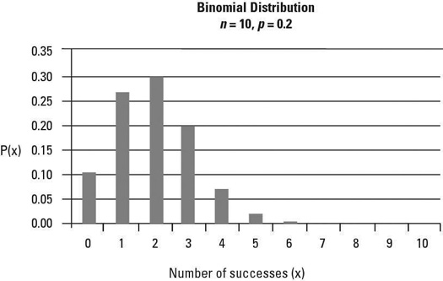
Binomial Distribution

Slide 3
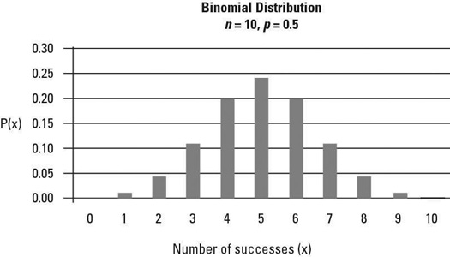
Binomial Distribution

Slide 4
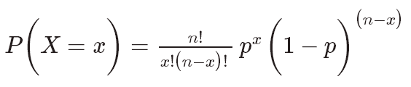
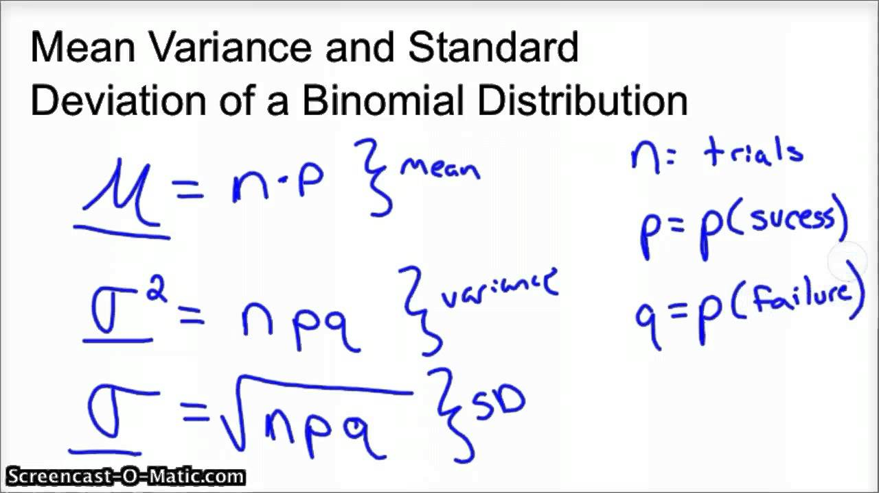
Binomial Distribution

Slide 5
PROOF

Slide 6
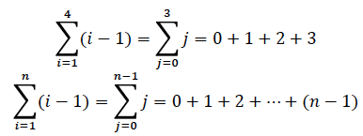
Review
Expected value of Y, E(Y)=?
Bernoulli distribution or Bernoulli trial: P(Y)=?
Binomial distribution (n Bernoulli trial): P(Y)=?
Mean and variance of Binomial distribution:
About using variable substitution:
Summation notation:
http://www.columbia.edu/itc/sipa/math/summation.html
The sum of a Geometric series: (see next page, from Page 836)
The Taylor series expansion of e^{x}:(see next page, from Page 836)

Slide 7
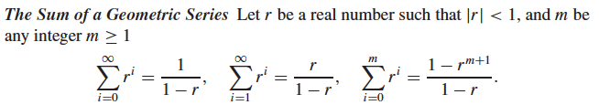

From page 836 on the textbook

Slide 8
Geometric Probability Distribution
Similar to binomial probability distribution, Geometric probability distribution:
Identical and independent trials
Two outcomes: “success” and “failure” with probabilities p and 1-p=q
Y: the number of trial on which the first success occurs
Find P(Y=y), the probability that the first success occurs on the y^{th} time (y=1, 2, 3, … )

Slide 9
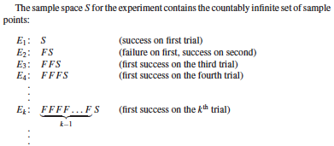

Slide 10
DEFINITION 3.8 (Page 3.8) A random variable Y is said to have a geometric probability distribution if and only if
p(y) = q^{y−1} p, y = 1, 2, 3, . . . , 0 ≤ p ≤ 1.
Are the two conditions of probability distribution satisfied?

Slide 11
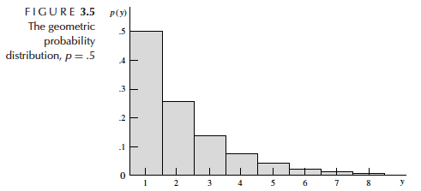

Slide 12
EXAMPLE 3.11 Suppose that the probability of engine malfunction during any one-hour period is p = .02.
(1) Find the probability that a given engine will survive exactly two hours.
(2) Find the probability that a given engine will survive at least two hours.

Slide 13

Proof:
-- See page 117 of the textbook

Slide 14
EXAMPLE 3.12 (page 117) If the probability of engine malfunction during any one-hour period is p = .02 and Y denotes the number of one-hour intervals until the first malfunction, find the mean and standard deviation of Y .

Slide 15
Geometric distribution:
Independent and identical trials with probability p of success
Y: the number of trial on which the first success occurs.
What if we are interested in the 2nd , 3rd , or 4th success occurs?
That is, Y is a random variable that is equal to the number of trial on which the r^{th} success occurs (r=2, 3, 4 etc.)
For example, if p=0.3,
y=3, r=2 p(y=3) = 2 X 0.3² X 0.7¹
y=4, r=2 p(y=4) = 3 X 0.3² X 0.7²
y=6, r=2 p(y=6) = 5 X 0.3² X 0.7⁴
(4) y=6, r=3 p(y=6) = 10 X 0.3³ X 0.7³

